Slide 1
Interesting AI
Dexter R. Shepherd, Paula Seidler, Alejandra Carriero

Slide 2
Recap
This course has looked at the building of data logging sensing devices
Developing good datasets that are usable by the research community
Visualising and developing more robust AI/ML models

Slide 3
Contents
Looking at current interesting AI, approaches and ideas on where things are going
Understanding of ethics surrounding these areas
More about starting to think about the implications of what we make - this is just as much a discussion as it is a lecture!

Slide 4
Current Trends in AI

Slide 5
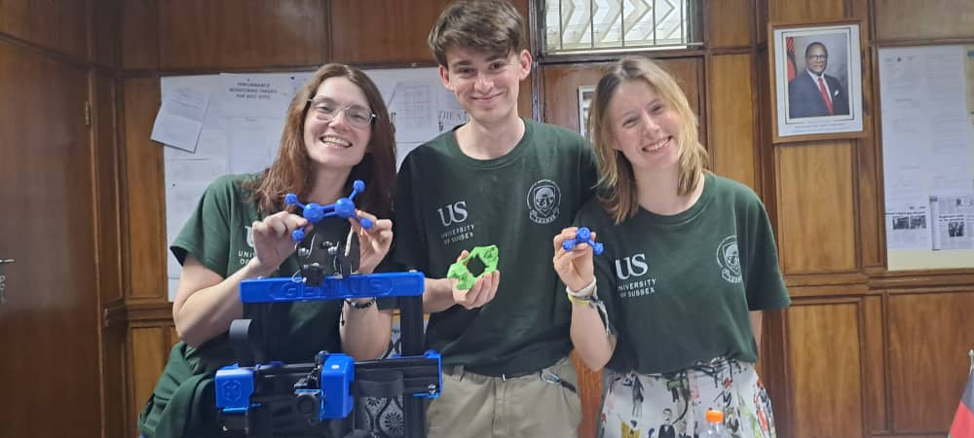
Impressive Generative AI: Did we really hike Bunda - or did we just pretend to?
We asked 3 different prompt/image-to-video AI models to create a video of us hiking up a mountain. Our prompt + image were:
“create an epic video of these three people(the three faces in the picture) climbing up a mountain. they are walking behind each each other, up into the sun. they are sweating but smiling. the mountain is very steep and there is some grass on it”

Slide 6
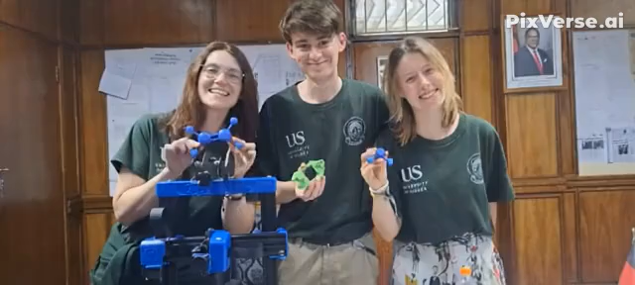
What did we get?

Slide 7
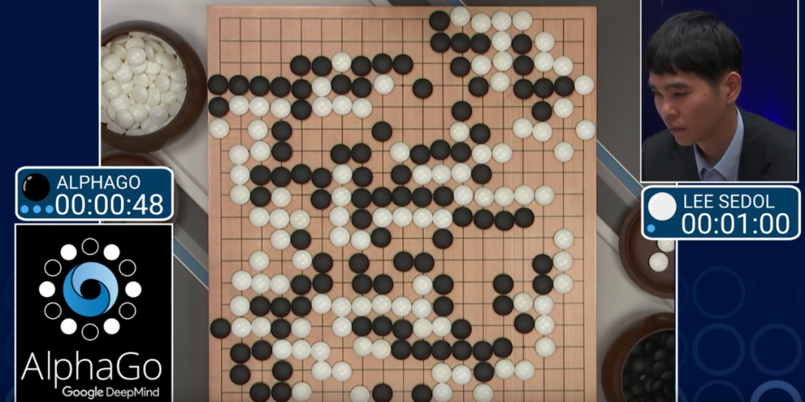
AlphaGo: Revolutionizing Gaming
Shocked the world by defeating a world champion Go player, which was a feat previously thought to be decades away.
This victory signified not merely an advancement in game-playing AI but also a breakthrough in strategic thinking and planning, demonstrating the potential of a new version of AlphaGo, called AlphaTensor, to tackle complex problems with the help of ChatGPT.

Slide 8

AlphaZero: Generalized Intelligence
A new model that learned to play chess, Go, and shogi from scratch, using only the game rules.
Through self-play and without human data, it reached superhuman performance, outperforming the programs specialized in each respective game.
This ability to self-learn and master multiple complex games from scratch speaks to the remarkable adaptability and efficiency of AI, capturing the essence of what it means to exhibit a form of generalized intelligence.

Slide 9
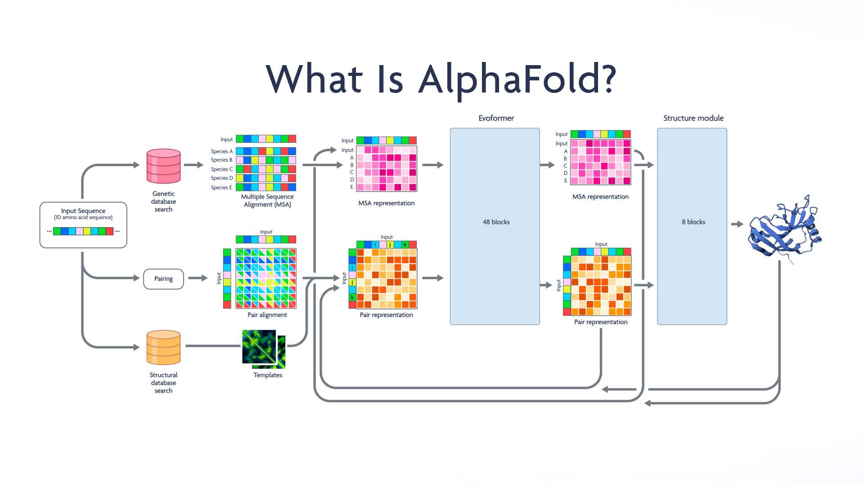
Revolutionizing Protein Folding: AlphaFold
AI has also made substantial contributions to the field of protein folding, which is a longstanding and intricate problem in biology.
With AlphaFold, DeepMind’s AI predicted the 3D structures of proteins with an unprecedented level of accuracy, a breakthrough in protein structure prediction heralded as a solution to a 50-year-old grand challenge in biology.
This achievement has profound implications for understanding disease mechanisms and drug discovery, potentially accelerating the pace at which medical treatments and advances can be made.

Slide 10
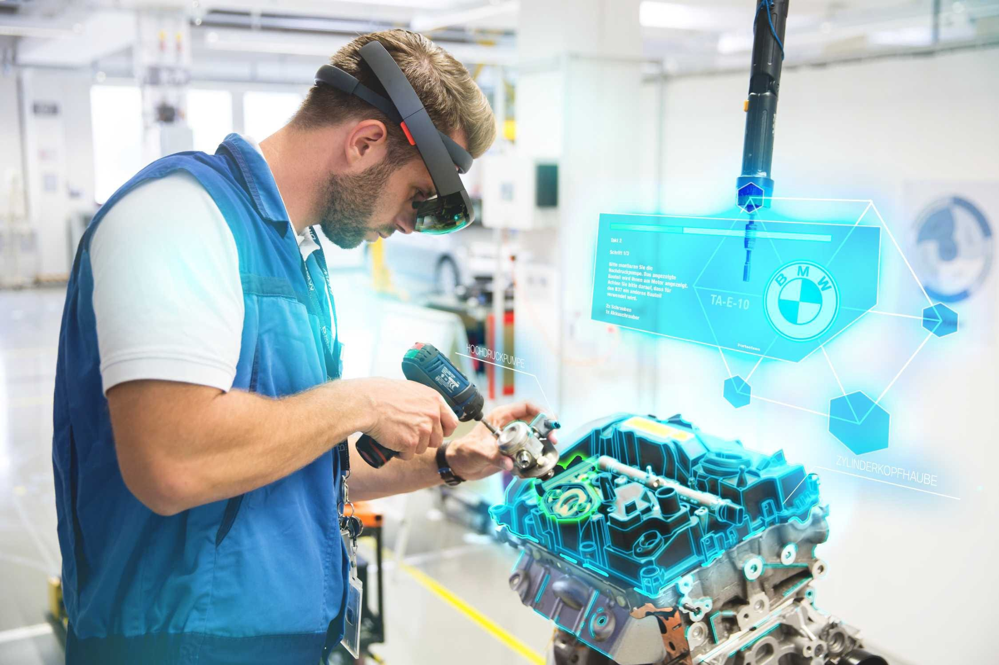
AI for Augmented Working
AI is becoming a crucial tool in various professions, enhancing human capabilities.
Examples:
AI-Guided Diagnostics in Surgery: Surgeons use AI to analyze medical images and guide procedures, improving accuracy and outcomes.
AI-Curated Case References for Attorneys: Legal professionals leverage AI to quickly find relevant case law and precedents, saving time and improving efficiency.
AI-Propelled Code Suggestions for Developers: Software developers benefit from AI tools that suggest code snippets and debug errors, speeding up development processes.
AI is improving efficiency, accuracy, and productivity across multiple fields, making it an indispensable part of modern work environments.

Slide 11
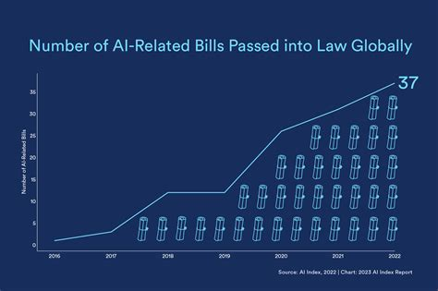
AI for Legislation
Governments worldwide are implementing policies to regulate AI.
Key Policies:
Comprehensive AI Policies: Establishing guidelines for the development and deployment of AI technologies.
Global Collaboration: Working with international partners to set benchmarks and norms for AI governance.
These efforts aim to foster innovation, attract investments, and protect citizens from potential risks associated with AI.

Slide 12
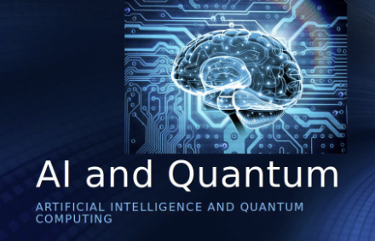
Quantum AI
Quantum computing is poised to revolutionize AI.
Key Developments:
Complex Problem-Solving: Quantum AI can tackle problems that are currently unsolvable by traditional computers, such as optimizing large-scale systems and simulating molecular structures.
The integration of quantum computing with AI promises to unlock new capabilities and accelerate advancements in various fields, including cryptography, materials science, and drug discovery.

Slide 13
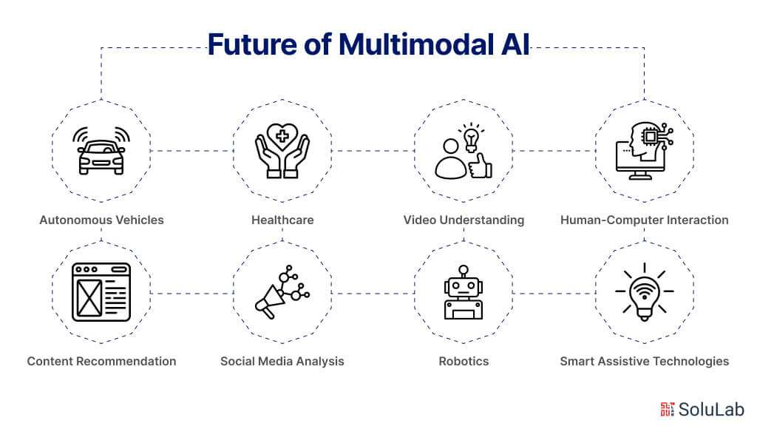
Multimodal AI
AI systems are increasingly capable of processing and integrating multiple types of data.
Key Developments:
Text, Images, and Audio: AI can analyze and combine information from different modalities to provide more comprehensive insights.
Multimodal AI enhances the accuracy and relevance of outputs, making it valuable for applications such as healthcare diagnostics, autonomous vehicles, and customer service.

Slide 14

Open Source Advancements
The development of open-source AI models is accelerating.
Key Developments:
Accessibility: Powerful AI tools are becoming more accessible to researchers, developers, and enterprises.
Open-source AI fosters innovation and collaboration, enabling rapid advancements and democratizing access to cutting-edge technologies

Slide 15
AI for classification

Slide 16
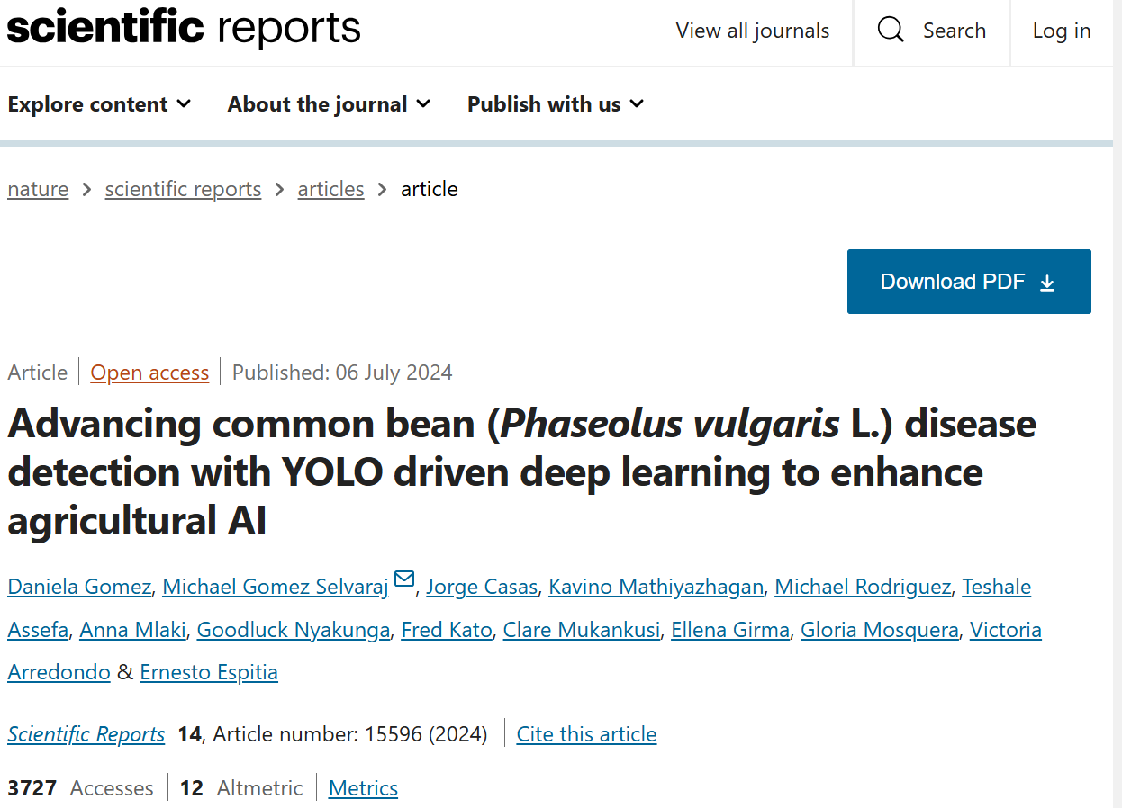
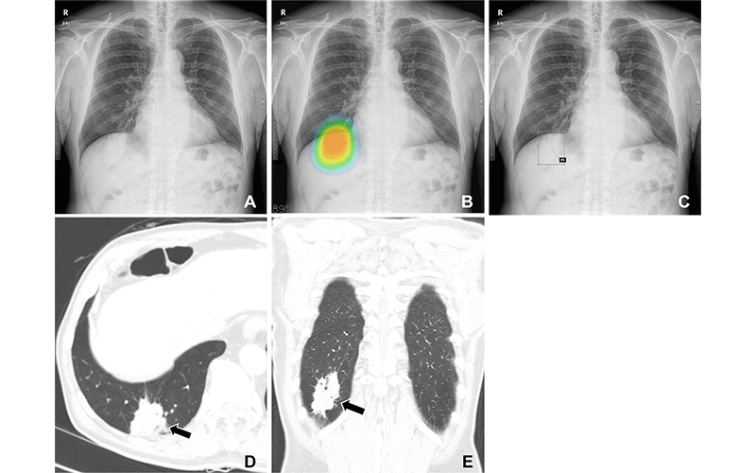
AI can be used for much good

Slide 17
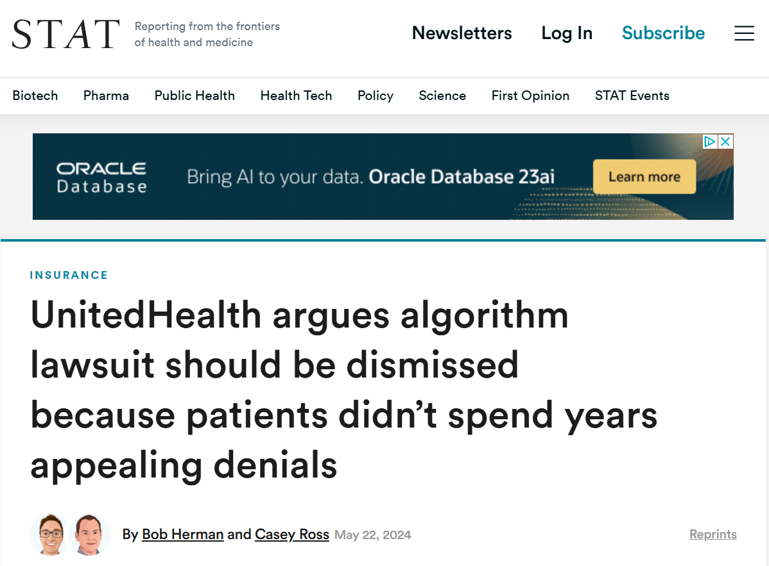
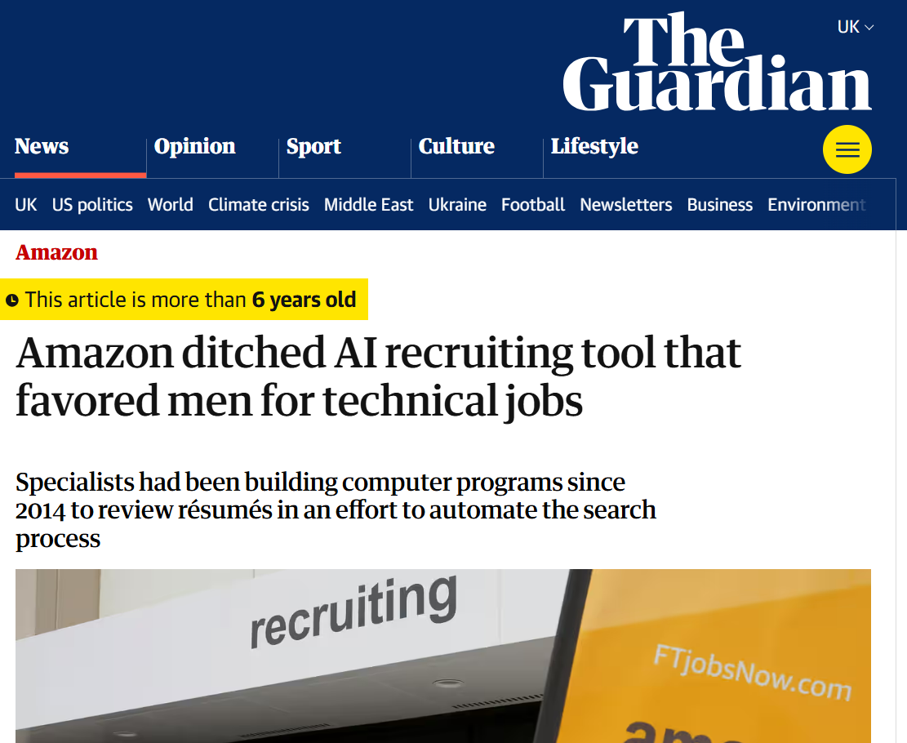

But also not as good tasks

Slide 18
Generative AI

Slide 19
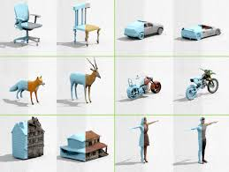
The many forms
Unlike AI for classification, generative AI generates new content
This can be
Videos
Music
Pictures
Text
Even 3D models

Slide 20

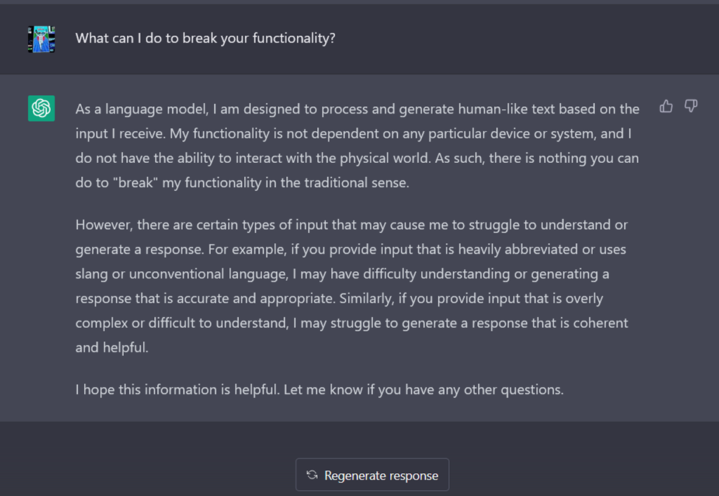
It has many positive impacts
Makes graphic design/ professional content cheaper/ more accessible for smaller businesses
Helps as the new google!

Slide 21


But it has many negative effects
Election interference
Fraud/scams
Misinformation

Slide 22

But does this mean stopping AI
This means security is on a new front
Notes:
Example of O2 using AI to waste time of scammers

Slide 23
Some of the social/legal implications to consider

Slide 24
Who is responsible for AI going wrong?
Is it the AI?
Is it the developers?
Is it the company who signs off the use of it?
Do people have to accept risk when using it?

Slide 25
What are peoples opinions on these matters?
Lets say an AI doctor is more accurate than a human, how do we feel about a 10% human error margin vs a 5% AI error?
Some are okay with healthcare but not okay with other decisions (eg insurance)

Slide 26
Environmental impacts of AI

Slide 27
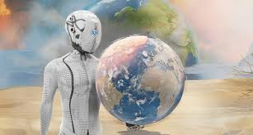
AI needs resources!
AI depends on large data centers, consuming massive energy and resources
A 2 kg computer needs 800 kg of raw materials
AI chips require rare earth elements, often mined destructively
Produces e-waste with hazardous substances

Slide 28

AI uses a lot of water!
Training AI models (e.g., GPT-3) can use 700,000 liters of water
AI infrastructure (data centers, etc.) may soon consume 6× Denmark’s water use

Slide 29
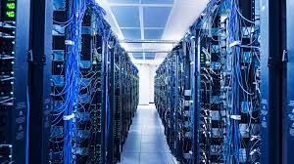
AI uses a lot of energy!
A single ChatGPT request uses 10× the electricity of a Google search
Training a single AI model can emit as much CO₂ as five cars over their lifetime

Slide 30
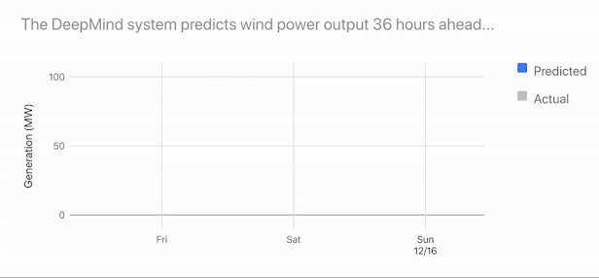
But there are ways to make it more energy efficient!

Slide 31
What do you think about AI?
How did this course change your views on it?

